Slide 1
Evolving Data-Intensive DB’s and Data Mesh
Damian A. Tamburri, Ph.D.

Slide 2
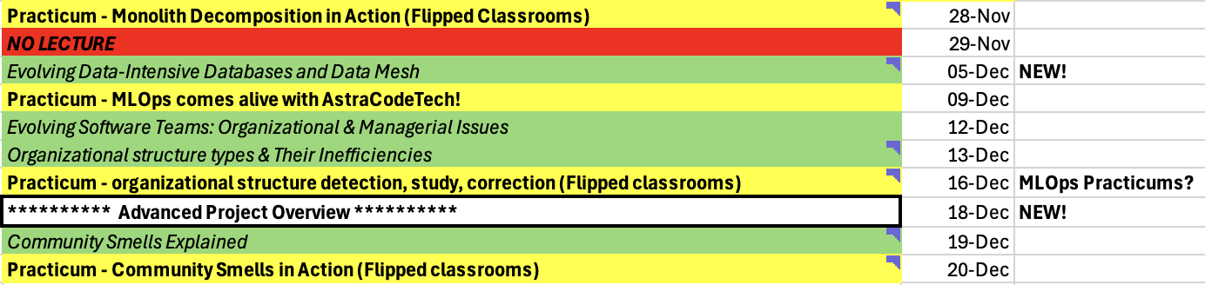

Slide 3
What are the Typical Components of a Big Data Architecture?
ML
Data Generation
Ingestion
Processing/
Transformation
Serving
Analytics
Storage
Reporting
Orchestration, Monitoring, and Governance

Slide 4

Data Ingestion
Data ingestion is the process of moving data from data sources to destination storage.
Source System
Data ingestion
Storage
For Analytics
Top stats (e.g., top tweet and top follower) for the last 30 seconds
Monthly overview of top stats
Conversion tracking (for Twitter Ads)
Storage
What should we consider when we ingest Twitter data?
Notes:
Key Engineering Considerations for the Ingestion Phase
When preparing to architect or build an ingestion system, here are some primary considerations and questions to ask yourself related to data ingestion:
What’s the use case for the data I’m ingesting?
Can I reuse this data and avoid ingesting multiple versions of the same dataset?
Where is the data going? What’s the destination?
How often should the data be updated from the source?
What is the expected data volume?
What format is the data in? Can downstream storage and transformation accept this format?
Is the source data in good shape for immediate downstream use? That is, is the data of good quality? What post-processing is required to serve it? What are data-quality risks (e.g., could bot traffic to a website contaminate the data)?
Does the data require in-flight processing for downstream ingestion if the data is from a streaming source?

Slide 5
Data Ingestion (Cont’d)
Batch Data Ingestion
Collecting and ingesting data in predefined, fixed-size chunks or batches periodically or on-demand.
Time interval-based or Size-based
Can handle large data volumes efficiently and is simple to implement.
Unsuitable for real-time applications.
Stream Data Ingestion
Data is ingested as soon as it is generated at the source systems.
Suitable for applications that require real-time insights and actions.
Message Brokers and Change Data Capture (CDC) Systems are widely used. (Lecture 10)
Any solution from the tools used by labs?
Notes:
Batch Data Ingestion Use Cases
Periodic Reporting: Batch ingestion is well-suited for generating periodic reports and analytics based on historical data.
Data Warehousing: Batch ingestion is commonly used for populating and updating data warehouses.
Offline Processing: When real-time insights are not essential, batch ingestion can be employed for various offline data tasks.
Streaming Data Ingestion Use Cases
Real-Time Analytics: Streaming ingestion is ideal for applications that require real-time analytics, such as fraud detection, monitoring, and recommendation systems.
Internet of Things (IoT) Data: Handling high-velocity data streams from IoT devices is a common use case for streaming ingestion.
Event Processing: Streaming ingestion is valuable for real-time event processing, such as social media sentiment analysis or stock market data analysis.
Change data capture (CDC) refers to the process of identifying and capturing changes made to data in a database and then delivering those changes in real-time to a downstream process or system.

Slide 6
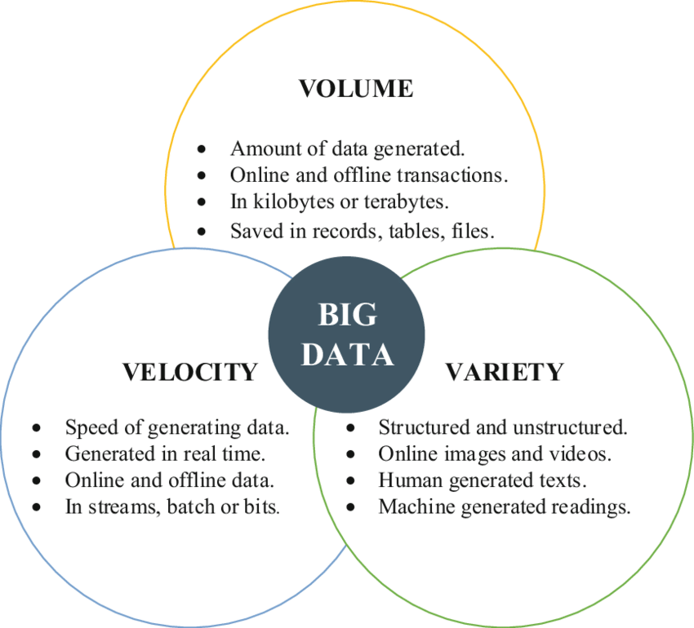
3-Vs and Data Ingestion
What Vs related to batch data ingestion?
What Vs related to stream data ingestion?
Notes:
https://link.springer.com/content/pdf/10.1007/978-981-287-251-7_38.pdf

Slide 7
Data Ingestion (Cont’d)
Ingestion Strategy
Pull (a source system sending data to a target)
Push (a target reading data directly from a source)
Poll (check periodically to detect any changes in the data sources; if Yes, pull)
Pull
Push
Source
Destination
Source
Destination
e.g., Twitter streaming API
e.g., Twitter Standard search API
Is there a change?
Source
Destination
Pull
If Yes, pull
Notes:
https://developer.twitter.com/en/docs/tutorials/listen-for-important-events

Slide 8
Data Ingestion
Homogeneous data ingestion
Move the data to the destination in the same format or same storage engine as it is in the source - extract and load.
Use cases:
Migrating on-premises relational databases or a portion of a database to a cloud relational database as a service (the same data engine).
Data files (e.g., CSV files) ingestion from on-premises storage to a cloud storage.
Large objects (BLOB, photos, videos) ingestion into a cloud (object) storage.
https://docs.aws.amazon.com/whitepapers/latest/aws-cloud-data-ingestion-patterns-practices/data-ingestion-patterns.html
Notes:
https://docs.aws.amazon.com/whitepapers/latest/aws-cloud-data-ingestion-patterns-practices/data-ingestion-patterns.html

Slide 9
Data Ingestion
Heterogeneous data ingestion
Data must be transformed as it is ingested into the destination data storage system.
This requires extract, transform, and load (ETL) workflows.
Use cases:
Relational data ingestion between different data engines
Relational data source to non-relational data destination and vice versa
File format transformations while ingesting data files (e.g., CSVs to Column-oriented data formats such as Parquet)
https://docs.aws.amazon.com/whitepapers/latest/aws-cloud-data-ingestion-patterns-practices/data-ingestion-patterns.html

Slide 10
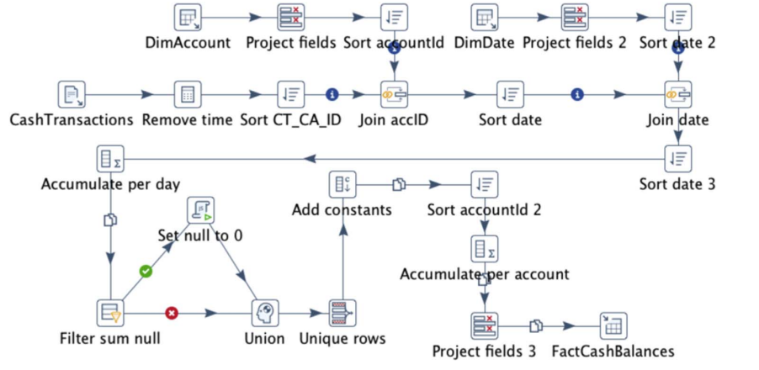
ETL Workflow Example: Fact Cash Balances Population
Data Sources
Data Target
Theodorou, Vasileios, et al. "Frequent patterns in ETL workflows: An empirical approach." Data & knowledge engineering 112 (2017): 1-16.

Slide 11
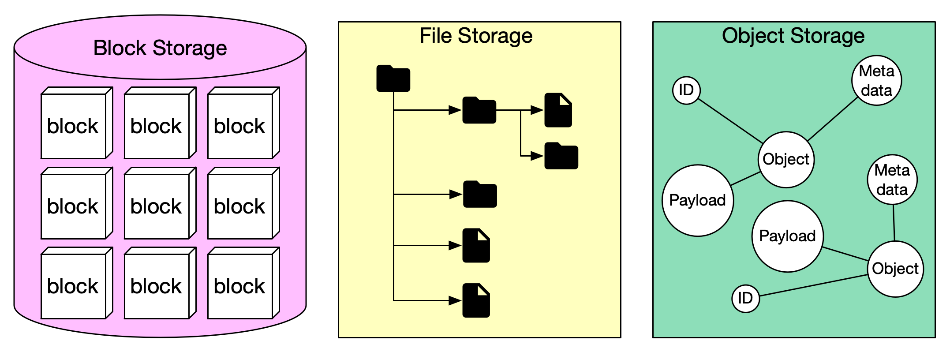
Data Storage : Fundamental Storage
Data can be recorded and stored in three main forms: block storage, file storage, and object storage.
Ref: https://blog.bytebytego.com/p/storage-systems-overview
https://www.ibm.com/blog/object-vs-file-vs-block-storage/

Slide 12
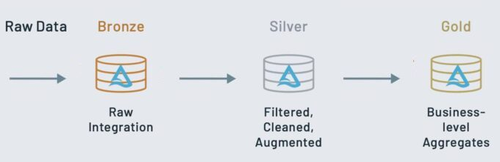
Data Storage : Fundamental Storage (Cont’d)
The data can be logically organized into bronze (raw), silver (validated), and gold (enriched).
Data processing pipelines
In what format (e.g., csv), the data should be stored in each layer?
Databricks Medallion Architecture
Apply operations such as aggregations, joins, and filtering
Notes:
https://learn.microsoft.com/en-us/azure/databricks/lakehouse/medallion
Ingest raw data to the bronze layer
The bronze layer contains unvalidated data. Data ingested in the bronze layer typically:
Maintains the raw state of the data source.
Is appended incrementally and grows over time.
Can be any combination of streaming and batch transactions.
Retaining the full, unprocessed history of each dataset in an efficient storage format provides the ability to recreate any state of a given data system.
Additional metadata (such as source file names or recording the time data was processed) may be added to data on ingest for enhanced discoverability, description of the state of the source dataset, and optimized performance in downstream applications.
Validate and deduplicate data in the silver layer
Recall that while the bronze layer contains the entire data history in a nearly raw state, the silver layer represents a validated, enriched version of our data that can be trusted for downstream analytics.
While Databricks believes strongly in the lakehouse vision driven by bronze, silver, and gold tables, simply implementing a silver layer efficiently will immediately unlock many of the potential benefits of the lakehouse.
For any data pipeline, the silver layer may contain more than one table.
Power analytics with the gold layer
This gold data is often highly refined and aggregated, containing data that powers analytics, machine learning, and production applications. While all tables in the lakehouse should serve an important purpose, gold tables represent data that has been transformed into knowledge, rather than just information.
Analysts largely rely on gold tables for their core responsibilities, and data shared with a customer would rarely be stored outside this level.
Updates to these tables are completed as part of regularly scheduled production workloads, which helps control costs and allows service level agreements (SLAs) for data freshness to be established.
While the lakehouse doesn’t have the same deadlock issues that you may encounter in a enterprise data warehouse, gold tables are often stored in a separate storage container to help avoid cloud limits on data requests.
In general, because aggregations, joins, and filtering are handled before data is written to the gold layer, users should see low latency query performance on data in gold tables.

Slide 13
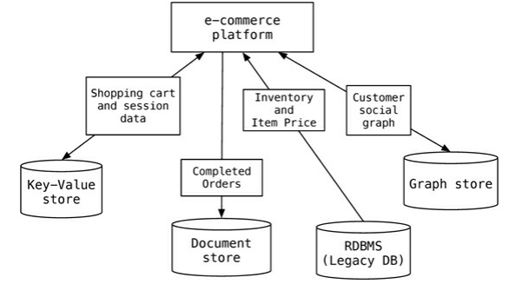
Data Storage: Databases
Polyglot Persistence Use different database technologies for different kinds of data and data access characteristics:
Need Not Only SQL Databases => NoSQL
https://martinfowler.com/bliki/PolyglotPersistence.html

Slide 14
Types of NoSQL Databases
NoSQL Databases
Key-Value Stores
Document Stores
Graph Databases
Columnar Databases

Slide 15
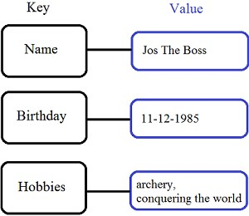
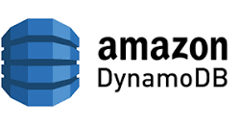
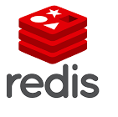
Key-value Store
Simple data model: key/value pairs
The value can be in any format.
Queries are limited to query by key
get/put/update/delete a key/value pair
iterate over key/value pairs
Generally, the data cannot be queried by the attributes of the value (Query by data).
Some Key-value stores provide a way to assign a schema for each value, sort the data by another key, and query (partially) by data.

Slide 16


Document Stores
Stores and retrieves documents, which can be XML, JSON, etc.
Similar in nature to key-value store, but the value is a document
Documents are self-describing, hierarchical tree data structures consisting of maps, collections, and scalar values.
Document databases have a flexible schema, meaning that not all documents in a collection need to have the same fields.
does not enforce any restrictions on the schema.
Support queries data by field values. Document databases provide their query languages.
Google
Notes:
Event Logging
Content Management Systems, Blogging Platforms
Web Analytics or Real-Time Analytics
E-Commerce Application

Slide 17
Example of a Simple Query (MongoDB)
Collection orders
{
_id: "a",
cust_id: "abc123",
status: "A",
price: 25,
items: [ { sku: "mmm", qty: 5, price: 3 },
{ sku: "nnn", qty: 5, price: 2 } ]
}
{
_id: "b",
cust_id: "abc124",
status: "B",
price: 12,
items: [ { sku: "nnn", qty: 2, price: 2 },
{ sku: "ppp", qty: 2, price: 4 } ]
}
db.orders.find(
{ status: "A" },
{ cust_id: 1, price: 1, _id: 0 }
)
selection
projection
{
cust_id: "abc123",
price: 25
}
In SQL, this would look like:
SELECT cust_id, price
FROM orders
WHERE status="A"

Slide 18
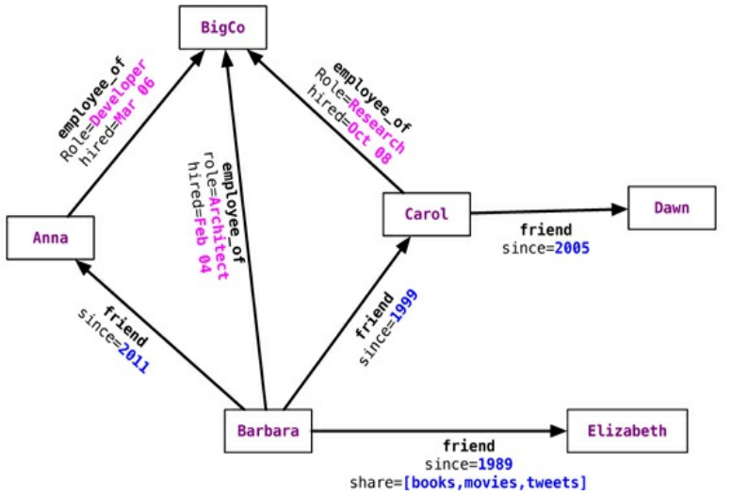


Graph Databases
Store entities and relationships between the entities as a graph.
Everything is stored as an edge, a node, or an attribute.
The organization of the graph allows the data to be stored once and then interpreted differently based on relationships.
A query on the graph is also known as traversing the graph.
MATCH (:Person {name: 'Carol'})-[:friend]->(p:Person)
RETURN p.name
Find the name of Carol's friend
Sadalage, Pramod J., and Martin Fowler. NoSQL distilled: a brief guide to the emerging world of polyglot persistence. Pearson Education, 2013.

Slide 19
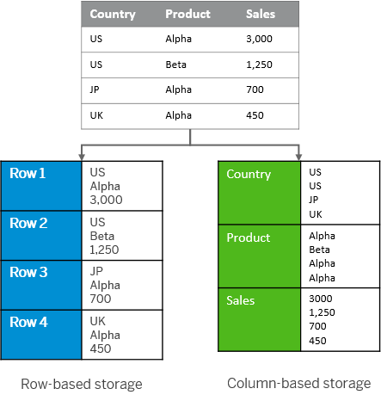


Column Store (Columnar Databases)
Stores data in columns rather than the rows used by traditional databases.
These databases perform particularly well with aggregation queries (such as SUM, COUNT, AVG, etc.).
https://help.sap.com/docs/SAP_HANA_PLATFORM/6b94445c94ae495c83a19646e7c3fd56/bd2e9b88bb571014b5b7a628fca2a132.html

Slide 20
Quiz
Consider the following typical data sources a healthcare information system (HIS) uses. Assign the most suited database (including relational databases) for each data source.
Doctor-patient Interactions (e.g., Consultations and Examinations).
Relations among symptoms and diagnosis
Patient photos
Medical bills
Financial data
Graph
Graph
Key-value
Document
Relational

Slide 21
Evolution means…
Changing from one data form to another
Hybridizing the Data Infrastructure
Evolving the Organizational Model

Slide 22
Evolving Big Data Architecture Styles
Data Lake
Data Warehouse
Lambda
Kappa
Data Lakehouse
Data Mesh

Slide 23
Data Lake
Store all types of structured and unstructured data as-is, without having to first format the data.
Other
sources
What is the ideal storage type for data storage?
Analysis
Query
Reports
Data mining
Operational
DBs
Extract
and
Load (EL)
Data Storage
Data Sources
Data Storage
Transformation
Serving
Notes:
Storage: Low-cost flexible (multi-model) storage – can store anything
data masking: the obfuscation of sensitive information so that the database can be used for development and testing purposes. The names and Social Security numbers of individuals in a database might be scrambled with random letters and numerals while still preserving the same length of each string, so that any database testing procedures can work with realistic (yet inauthentic) data.

Slide 24
Data Warehouse Architecture
OLAP (Online analytical processing) is to support ad-hoc querying for the business analysts.
A data mart is a subset of a data warehouse focused on a particular line of business, department, or subject area (Subject-oriented).
Other
sources
OLAP Server
Analysis
Query
Reports
Data mining
Operational
DBs
Extract
Transform
Load (ETL)
Data
Warehouse
Serve
Data Marts
Data Sources
Data Storage
OLAP Engine
Serving
Notes:
Subject-oriented. Support analyzing data about a particular subject or functional area (such as sales).

Slide 25
OLTP vs OLAP
On-Line Transaction Processing – OLTP
Maintains a database that is an accurate model of some real-world enterprise. Supports day-to-day operations. Characteristics:
Short simple transactions
Relatively frequent updates
Transactions access only a small fraction of the database
On-Line Analytic Processing – OLAP
Uses information in the database to guide strategic decisions. Characteristics:
Complex queries
Infrequent updates
Transactions access a large fraction of the database
Data need not be up-to-date
Notes:
OLTP
Automated teller machines (ATMs)
Online banking applications
Online bookings
E-commerce and in-store purchases
Online and in-store credit card payment processing

Slide 26
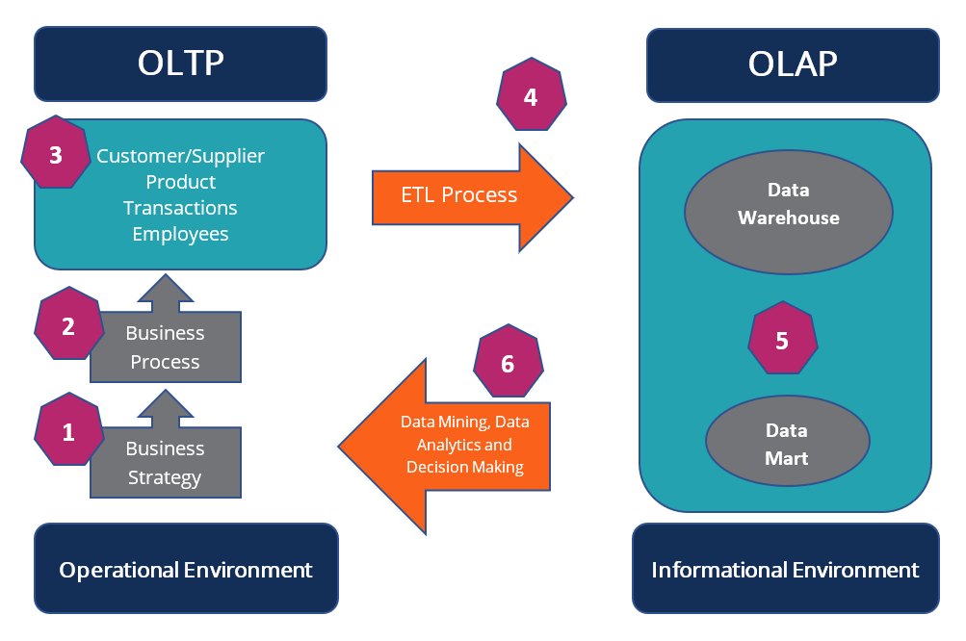
OLTP vs OLAP (Cont’d)
https://corporatefinanceinstitute.com/resources/data-science/oltp/
Notes:
https://corporatefinanceinstitute.com/resources/data-science/oltp/

Slide 27
OLPT and OLAP Example: The Internet Grocer
OLTP-style transaction:
John Smith, from Schenectady, N.Y., just bought a box of tomatoes; charge his account; deliver the tomatoes from our Schenectady warehouse; decrease our inventory of tomatoes from that warehouse
OLAP-style transaction:
How many cases of tomatoes were sold in all northeast warehouses in the years 2000 and 2001?

Slide 28
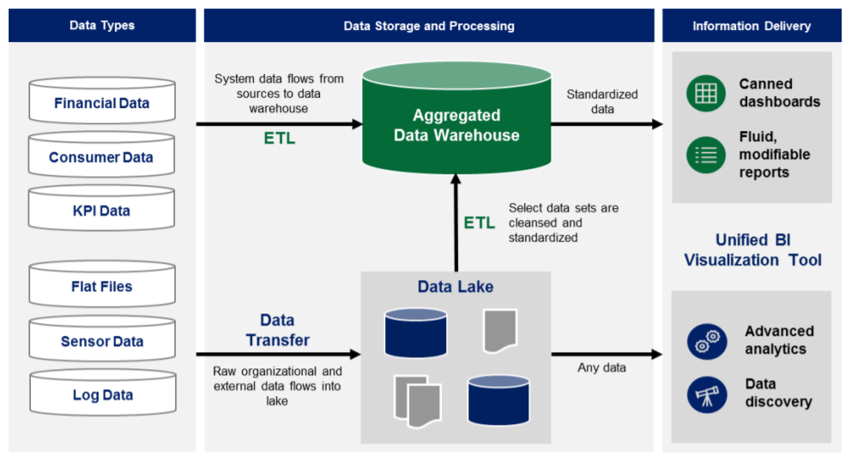
Data Lake and Data Warehouse
source: https://www2.deloitte.com/content/dam/Deloitte/tr/Documents/deloitte-analytics/Modern%20Business%20Intelligence.pdf

Slide 29
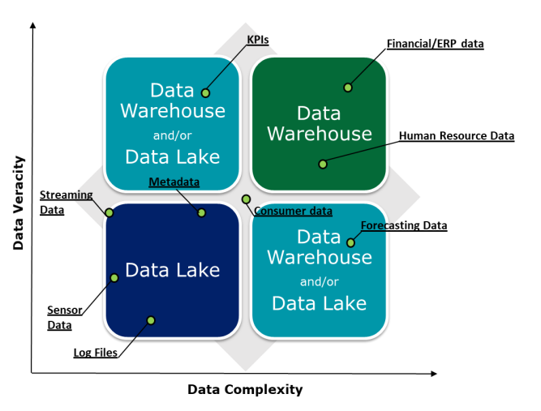
Data Lake and Data Warehouse (Cont’d)
The higher the veracity (accuracy, factual) and complexity of the data set at hand, the more cleansing, transforming, and organizing the data set will require.
source: https://www2.deloitte.com/content/dam/Deloitte/tr/Documents/deloitte-analytics/Modern%20Business%20Intelligence.pdf

Slide 30
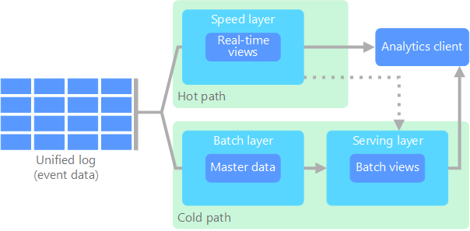
Evolving Lambda Architectures
Updates the serving layer with incremental updates based on the most recent data.
Purpose: To get some results in real-time in addition to the offline analytics.
Hot path (stream processing)
Cold path (batch processing)
Master data represents "data about the business entities that provide context for business transactions" - information about customers, suppliers, employees, stores, etc.
Business Transaction: Buyer X placed an order for 10 of SKU Y, on DD-MM-YYYY for a total of $5000.
The buyer and the product are comprised of master data.
https://learn.microsoft.com/en-us/azure/architecture/data-guide/big-data/
https://www.tibco.com/reference-center/what-is-master-data
Notes:
In general, the data captured by businesses falls into one of these three categories:
Transactional data: Transactional data is data that is generated by various applications while running or supporting everyday business processes.
Analytical data: Analytical data, as the name suggests, comes into being through calculations or analyses run on the transactional data.
Master data: Master data represents the actual, critical business objects upon which said transactions are performed, also taking into account the parameters on which data analysis is conducted.

Slide 31
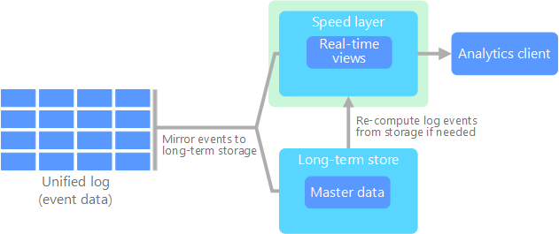
Evolving Kappa Architectures
All data flows through a single path using a stream processing system.
Alternative to lambda architecture and avoid duplicate computation logic and the complexity of managing both host and cold paths.
Collect data for an X duration and do batch processing to compute the state Y = Incrementally update the state Y over a duration X
https://learn.microsoft.com/en-us/azure/architecture/data-guide/big-data/
Notes:
The streaming layer supports both batch and real-time processing by the buffering of historical data in a logging system for long enough. When recomputation is required, a new stream processing job is launched alongside an old one. It recomputes the historical data and outputs different results into the Serving layer. After the new job has caught up the old one, back-end systems read from the new result. In addition, the old job is terminated and the corresponding output result is deleted

Slide 32
Towards Hybrid Infrastructures: Data Auto-Modeling for Data Warehouses *
*Thes slides are based on the Chapter 4 of the book: J. Han, M. Kamber and J. Pei, “Data Mining: Concepts and Techniques”.

Slide 33
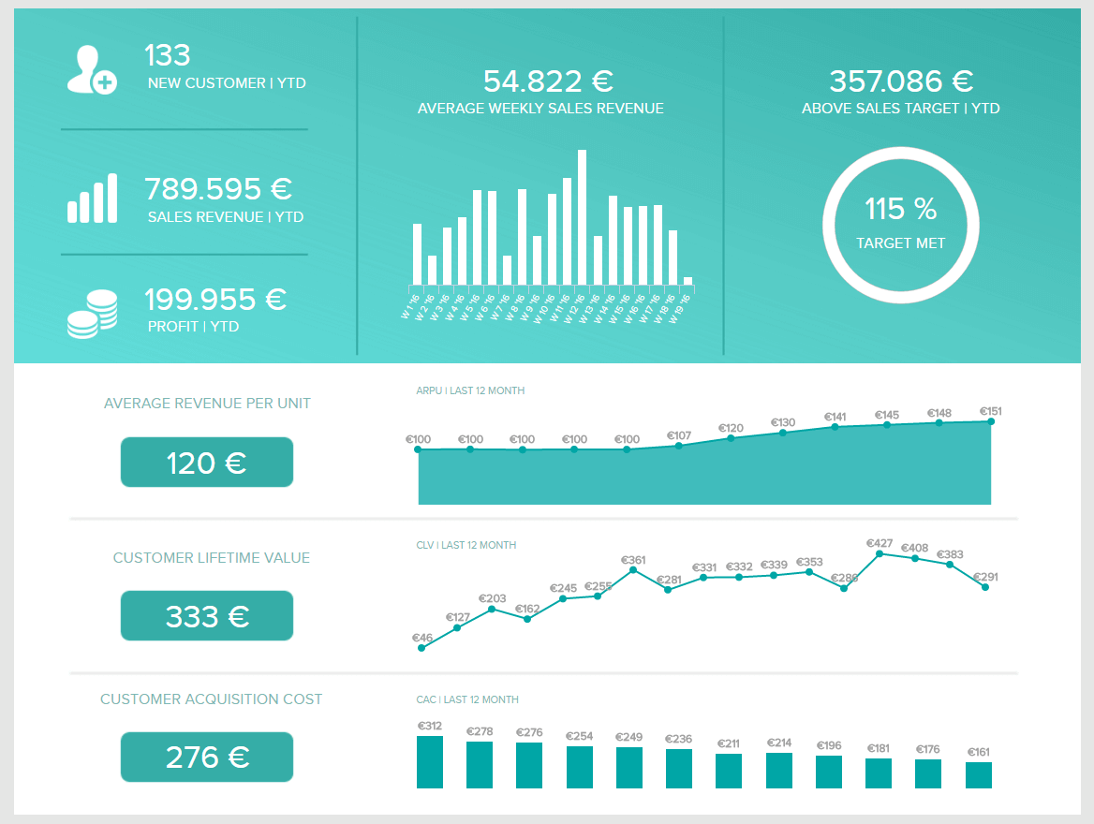
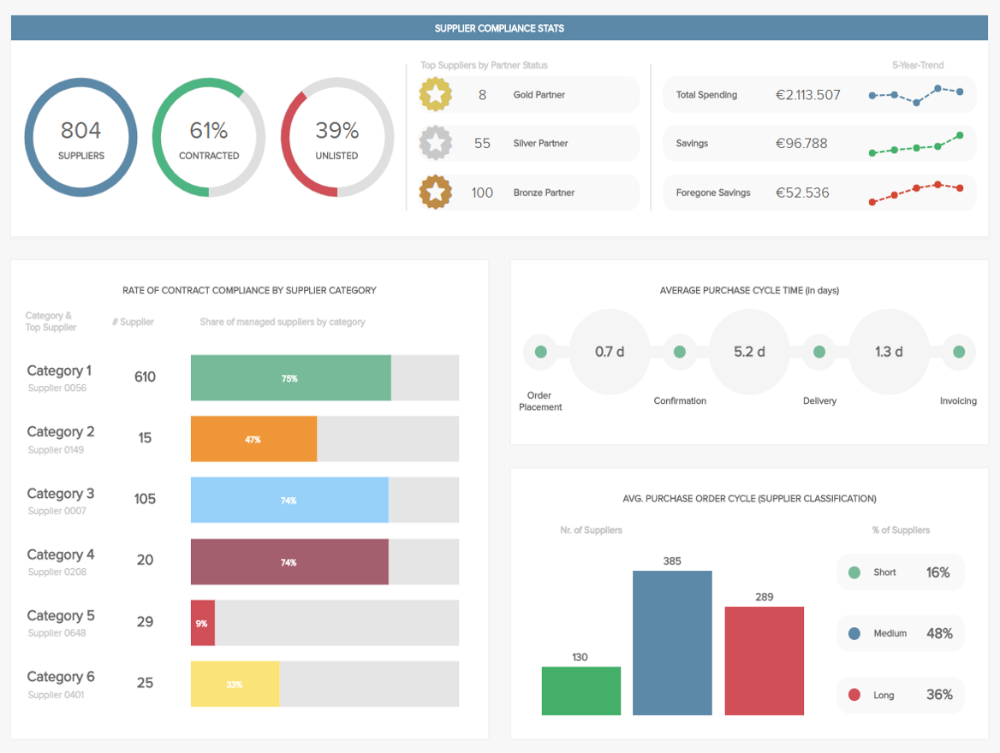
What is Business Intelligence?
Business intelligence (BI) is software that ingests business data and presents it in user-friendly views such as reports, dashboards, charts, and graphs. [IBM]
Business users (e.g., operations and strategy managers) can analyze this information to gain insights into how the business is performing. [IBM]
Subject-oriented: Provides information on a topic (such as sales, suppliers, students, teachers)
A sales report
A procurement dashboard
Ref: https://www.datapine.com/blog/business-intelligence-reporting/
Notes:
https://www.ibm.com/topics/business-intelligence

Slide 34
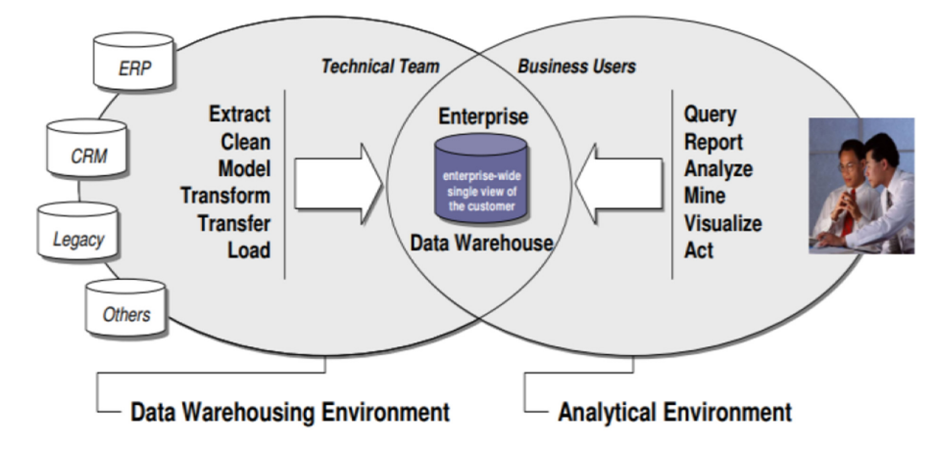
Typical Enterprise BI Environment
Fraihat, Salam, et al. "Business Intelligence Framework Design and Implementation: A Real-estate Market Case Study." ACM Journal of Data and Information Quality (JDIQ) 13.2 (2021): 1-16.

Slide 35
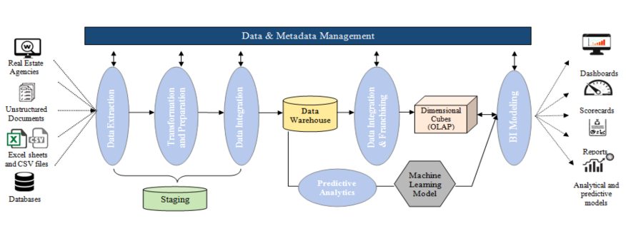
A Typical Data Architecture of a BI Env : A Real-Estate Case Study
Fraihat, Salam, et al. "Business Intelligence Framework Design and Implementation: A Real-estate Market Case Study." ACM Journal of Data and Information Quality (JDIQ) 13.2 (2021): 1-16.
Notes:
Data extraction sources data from disparate sources including the following: (i) statistical documents and reports, for example, from the land register (these data tend to be unstructured); (ii) data available in spreadsheets and CSV files; (iii) databases of historical prices and market data; and (iv) real estate agencies’ website data. Data cleansing, transformation, and integration take place as part of the “staging” operations. Formatted, clean data are then loaded into the DW. Basic and advanced analytics can then be performed within the DW, including predictive analytics with machine learning algorithms. Furthermore, DW offers OLAP cubes that support the provision of insights via analysis. To design the OLAP cubes, some data franchising and integration operations are performed within DW. The analytics are supported with interactive styles, including scoreboards, reports, predictive models, and interactive dashboards.

Slide 36
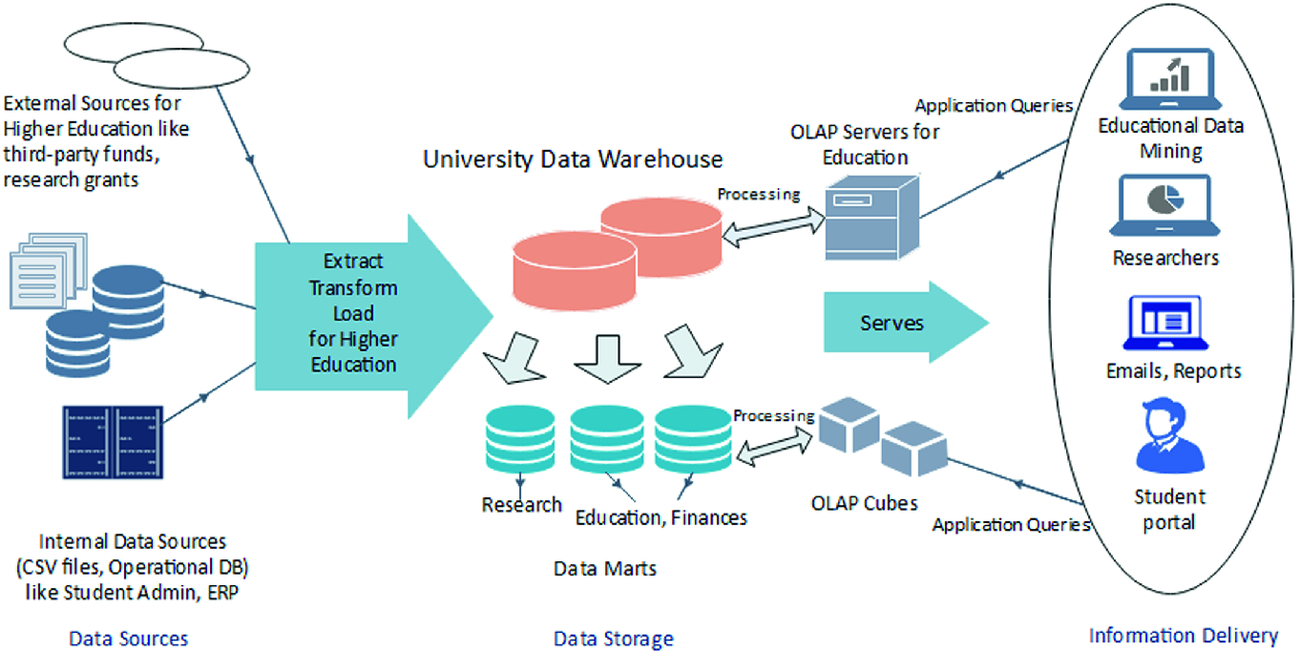
A Typical Data Architecture of a BI Env : University Case Study
Suman, S., Khajuria, P., Urolagin, S. (2020). Star Schema-Based Data Warehouse Model for Education System Using Mondrian and Pentaho. In: Goel, N., Hasan, S., Kalaichelvi, V. (eds) Modelling, Simulation and Intelligent Computing. MoSICom 2020. Lecture Notes in Electrical Engineering, vol 659. Springer, Singapore. https://doi.org/10.1007/978-981-15-4775-1_4

Slide 37
Warehouse Data Modeling
A data warehouse is based on a multidimensional data model that views data as a data cube.
Some examples of Dimensions are product (product_name, brand, type), and time (day, week, month, quarter, year)
For one or more dimensions, the facts are measured (such as dollars_sold and units_sold)
Common measure types?
We can answer questions such as:
What are sales for our eastern region versus our western region this year, compared to last year?
What is the quarterly contribution of research papers by each unit in UniSannio?
Notes:
count(), sum(), min(), max()
avg(), min_N(), standard_deviation()
Rank()
A dimension is a structure that categorizes facts and measures in order to enable users to answer business questions. Commonly used dimensions are people, products, place and time.
Most often, OLAP measure meaning is a numeric value by which the dimension is detailed or aggregated. It specifies a certain OLAP dimension and answers the “How much…?” question. For example, information about totaled bike sales is set out in one of the measures.

Slide 38
Multidimensional Data
Sales volume as a function of product, month, and region
Dimensions: Product, Location, Time
Hierarchical summarization paths
Region
Industry Region Year
Category Country Quarter
Product City Month Week
Office Day
Product
Month

Slide 39
A Sample Data Cube
Date
Total annual sales
of TVs in U.S.A.
1Qtr
2Qtr
3Qtr
4Qtr
sum
Product
TV
PC
c
U.S.A
VCR
sum
Canada
a
Country
Mexico
What are a, b, and c?
sum
b
All, All, All
Notes:
A – all products, USA in 3rd qtr
B - all products, all countries in 4th qtr
C- PC, 2nd Qtr, USA

Slide 40
Typical OLAP Data Evolution Patterns
Roll up (drill-up): summarize data
by climbing up hierarchy or by dimension reduction
Drill down (roll down): reverse of roll-up
from higher level summary to lower-level summary or detailed data, or introducing new dimensions
Slice and dice: project and select
Pivot (rotate):
reorient the cube, visualization, 3D to series of 2D planes

Slide 41
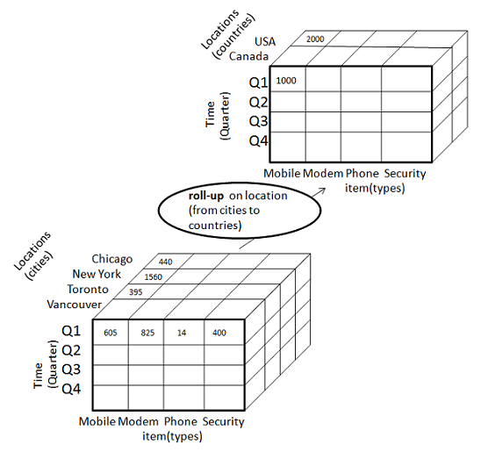
Rollup
2000 =
440 (Chicago) + 1560 (New York)
Industry Region Year
Category Country Quarter
Product City Month Week
Office Day
https://www.tutorialspoint.com/dwh/dwh_olap.htm

Slide 42
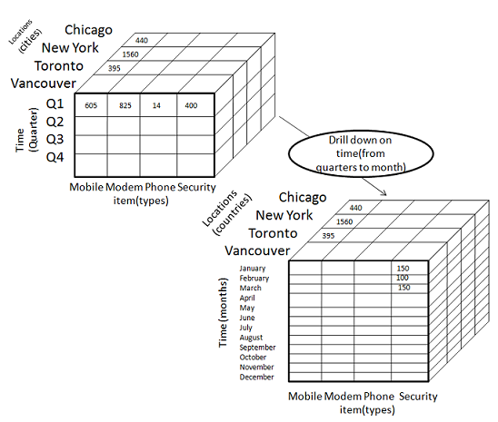
Drill Down
400 (Q1) = 150 (Jan) + 100 (Feb) + 150 (March)
Only show one example
Industry Region Year
Category Country Quarter
Product City Month Week
Office Day
https://www.tutorialspoint.com/dwh/dwh_olap.htm

Slide 43
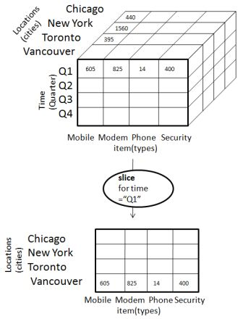
Slice
The slice operation selects one particular dimension from a given cube and provides a new sub-cube.
Only show the values for Vancouver
https://www.tutorialspoint.com/dwh/dwh_olap.htm

Slide 44
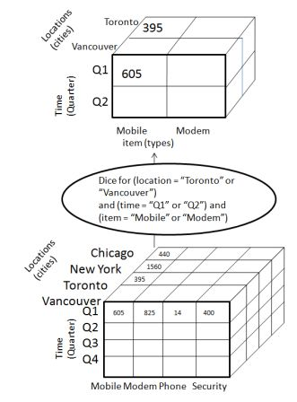
Dice
Dice selects two or more dimensions from a given cube and provides a new sub-cube.
https://www.tutorialspoint.com/dwh/dwh_olap.htm

Slide 45
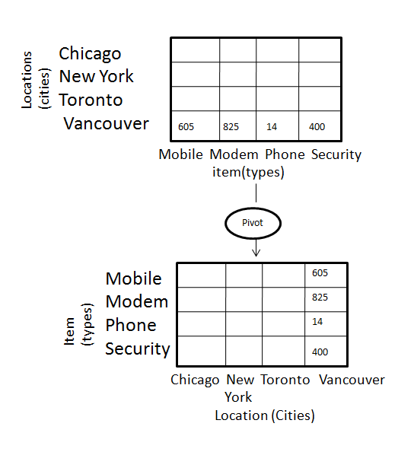
Pivot
The item and location axes in a 2-D slice are rotated
Rotates the data axes in view in order to provide an alternative presentation of data.
https://www.tutorialspoint.com/dwh/dwh_olap.htm

Slide 46
Conceptual Modeling of Data Warehouses: Implementing Data Cubes
Modeling data warehouses: dimensions & measures
Star schema: A fact table in the middle connected to a set of dimension tables
Snowflake schema: A refinement of star schema where some dimensional hierarchy is normalized into a set of smaller dimension tables, forming a shape similar to snowflake
Fact constellations: Multiple fact tables share dimension tables, viewed as a collection of stars, therefore called galaxy schema or fact constellation

Slide 47
Example of Star Schema
time
time_key
day
day_of_the_week
month
quarter
year
item
item_key
item_name
brand
type
supplier_type
Sales Fact Table
time_key
item_key
branch_key
branch
location
location_key
location_key
street
city
state_or_province
country
branch_key
branch_name
branch_type
units_sold
dollars_sold
avg_sales
Measures

Slide 48
Example of Snowflake Schema
time
item
time_key
day
day_of_the_week
month
quarter
year
item_key
item_name
brand
type
supplier_key
supplier
Sales Fact Table
supplier_key
supplier_type
time_key
item_key
branch_key
branch
location
location_key
location_key
street
city_key
branch_key
branch_name
branch_type
units_sold
dollars_sold
city
avg_sales
city_key
city
state_or_province
country
Measures
Notes:
https://learn.microsoft.com/en-us/office/troubleshoot/access/database-normalization-description

Slide 49
Example of Fact Constellation
time
time_key
day
day_of_the_week
month
quarter
year
item
Shipping Fact Table
item_key
item_name
brand
type
supplier_type
time_key
Sales Fact Table
time_key
item_key
item_key
shipper_key
branch_key
from_location
branch
location_key
location
to_location
branch_key
branch_name
branch_type
units_sold
location_key
street
city
province_or_state
country
dollars_cost
dollars_sold
units_shipped
avg_sales
shipper
Measures
shipper_key
shipper_name
location_key
shipper_type

Slide 50
Selection of Schema
Data Warehouse
The fact constellation schema is commonly used as it can model multiple, interrelated subjects (e.g., sales, shipping, and manufacturing).
Data marts
The star or snowflake schema is commonly used as the scope of a data mart is one or few subjects.
The star is the most popular and efficient.
Notes:
https://stackoverflow.com/questions/2623852/why-are-joins-bad-when-considering-scalability

Slide 51
Evolving Data Warehouses…
Data Mesh!

Slide 52
Latest data management approaches
Data Fabric → Defines a data infrastructure architecture
Unified view of heterogenous data served through secure and standard interface
Automated data integration mechanisms
Data Mesh → Organizational approach
Domain ownership → Domains teams are accountable for their data
Data as a product → Apply product thinking. Data products must be discoverable, understandable, accessible and reusable.
Self-service data infrastructure → Shared data infrastructure that helps data domains in the creation of data products
Federated governance → Definition of policies for data access and privacy; central policies for data interoperability
Data Fabric facilitates the creation of Data Products
Data Mesh facilitates the fruition of Data Products

Slide 53
Data Mesh
Data Mesh is a data architecture and organizational framework that decentralizes data ownership and management, treating data as a product and enabling scalability and agility in data-driven organizations.
It involves breaking down data infrastructure into smaller, self-contained units called "data domains" or "data products," each with its own cross-functional team responsible for data quality, governance, and delivery, fostering a more scalable and collaborative approach to data management.

Slide 54
Optimised Architectures
Content Delivery Scopes
Model 1 – Team BI
Model 2 – Departmental BI
Model 3 – Enterprise BI
 | End Users | Business Units | Power BI Champions
Data Assets |  | X
Vizualisation Assets |  | X
 | End Users | Business Units | Power BI Champions
Data Assets |  | X
Vizualisation Assets | X
 | End Users | Business Units | Power BI Champions
Data Assets |  |  | X
Vizualisation Assets | X
Business Units own and share data within their own teams.
Typically, less security and governance requirements.
Business Units own the data and make reporting available to end users.
Follows a ‘Data mesh’ architecture.
Centralised team own the data and allow end users self-service reporting.
Used for important and business critical reporting.

Slide 55
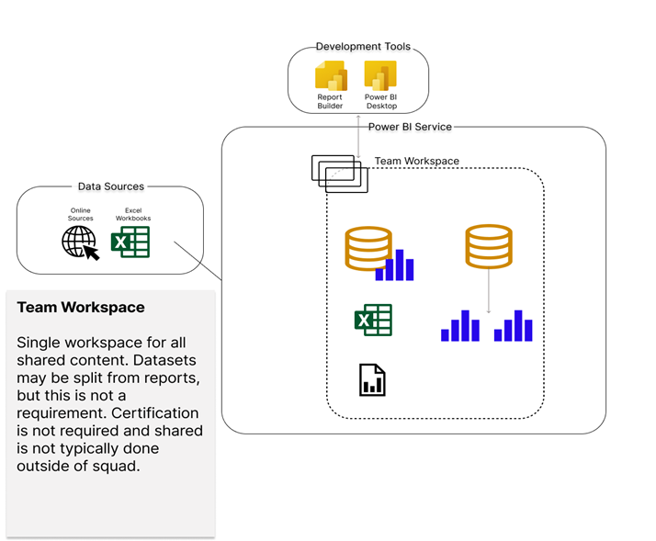
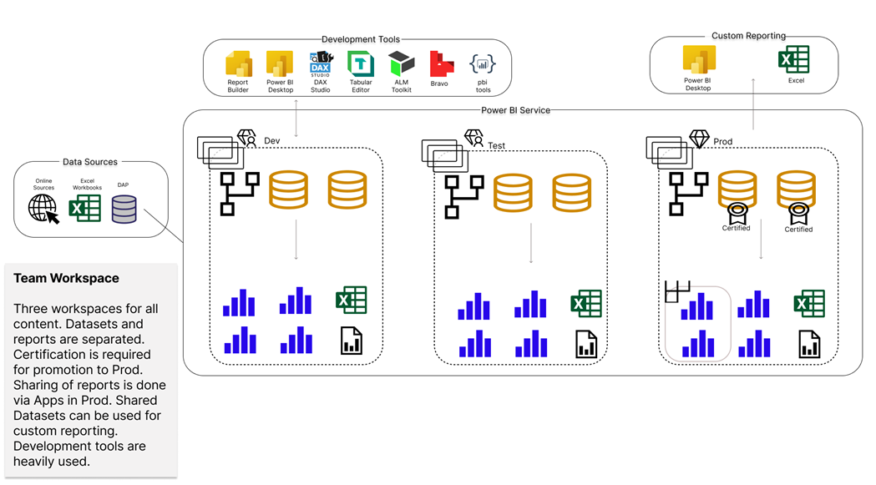
Optimised Architectures
Architectural Diagrams Examples
Model 1 – Team BI
 | End Users | Business Units | Power BI Champions
Data Assets |  | X
Vizualisation Assets |  | X
SQL

Slide 56
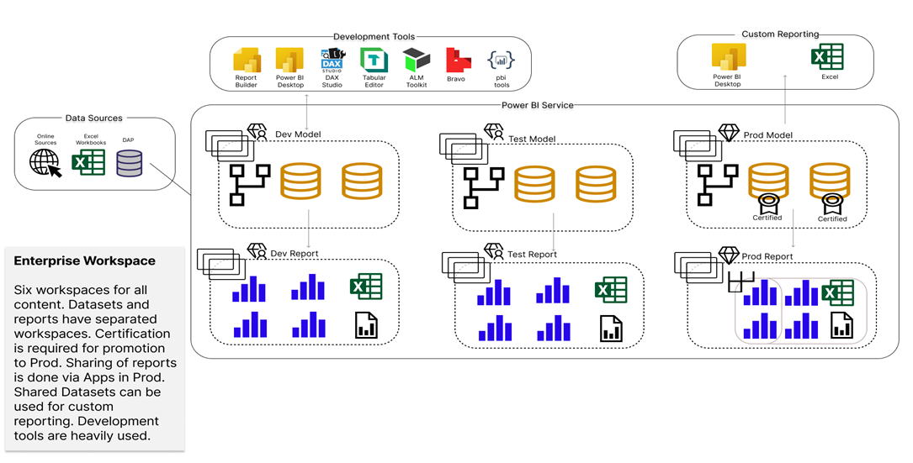

Optimised Architectures
Architectural Diagrams Examples
Model 3 – Enterprise BI
 | End Users | Business Units | Power BI Champions
Data Assets |  |  | X
Vizualisation Assets | X
Online
Sources
Delta
SQL
SQL

Slide 57
For Example: AAD Groups
Azure Active Directory (AAD) groups should be leveraged to increase control and visibility in who is shared with what
These can be reused across different workspace and Apps
Access control sits with IT and can be centrally managed and monitored
They are good for uses in Enterprise models, where additional oversight and security is needed
In personal or team BI they may slow down a user getting access to a report

Slide 58
AAD Groups
Grouped into functions
Name | Workspace | Access | Description
Admins\ Development Team | All | Admin Access or Member Access | Admin - Manage access and security to Workspace. Development Team - In charge of certifying datasets to tier 1.
Developers | Test (Member) DEV (Contributor) | Contributor or Member Access | Create and update content. If you want tighter control, assign contributor access and admins can manage many properties. You can also assign Member access on UAT workspaces and allow developers to self-manage, reducing gatekeepers.
Testers | Test | Viewer Access | Usually a group of key stakeholders, leads, and developers checking the reports function well and meets requirements.
 | PROD (App Only) | Viewer Access (App only) | The business users who will view the reports
Business Users

Slide 59
AAD Groups
AAD Groups follow levels
Business Users
An example
Finance Team
Sales Team
Managers
Team leaders
Salespeople
Managers
Department team members
See All Data
Static RLS on location
See all Data
Dynamic RLS on own team
OLS – no salary information
Dynamic RLS on own sales only

Slide 60
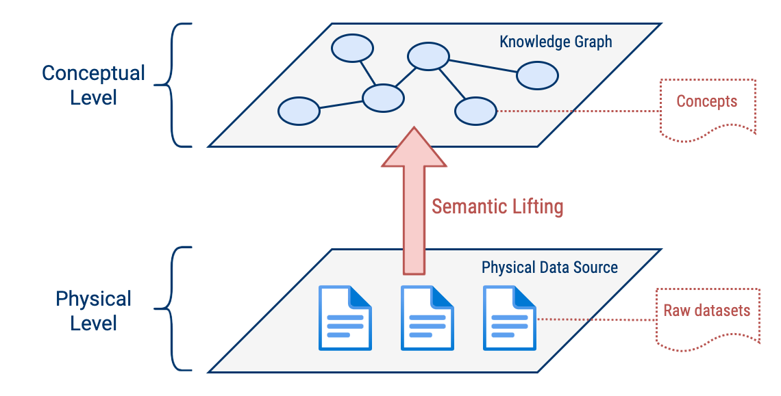
Key Enabler: The almighty Knowledge Graph
Concepts and their relations with other concepts are represented in a graph
Leverage ontologies and taxonomies to explicitly capture knowledge
Instances and categories/classes are combined in the graph
Knowledge graph standards:
W3C Semantic Web → RDF, OWL
ETSI NGSI-LD (Property Graphs + Ontologies)
Enabler of the data fabric paradigm
Data integration thanks to semantic layer
(Raw) Datasets are mapped to concepts
Also known as ontology mapping or semantic lifting
Data mesh proposal →
Data product as the conceptual representation of raw datasets

Slide 61
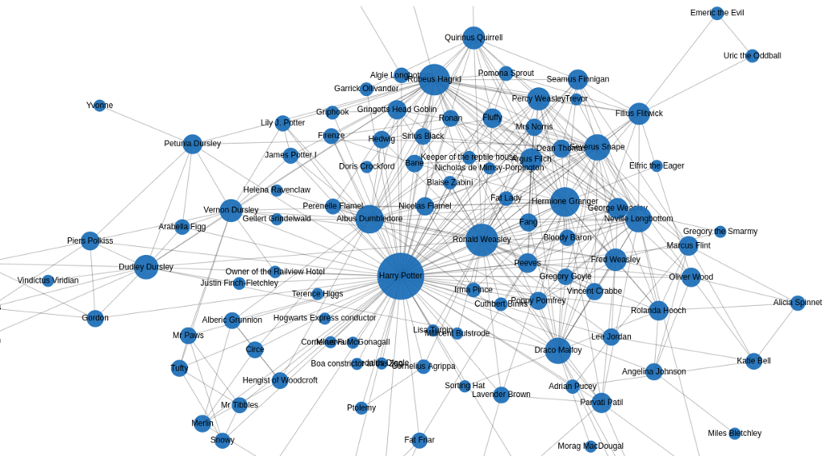

Slide 62
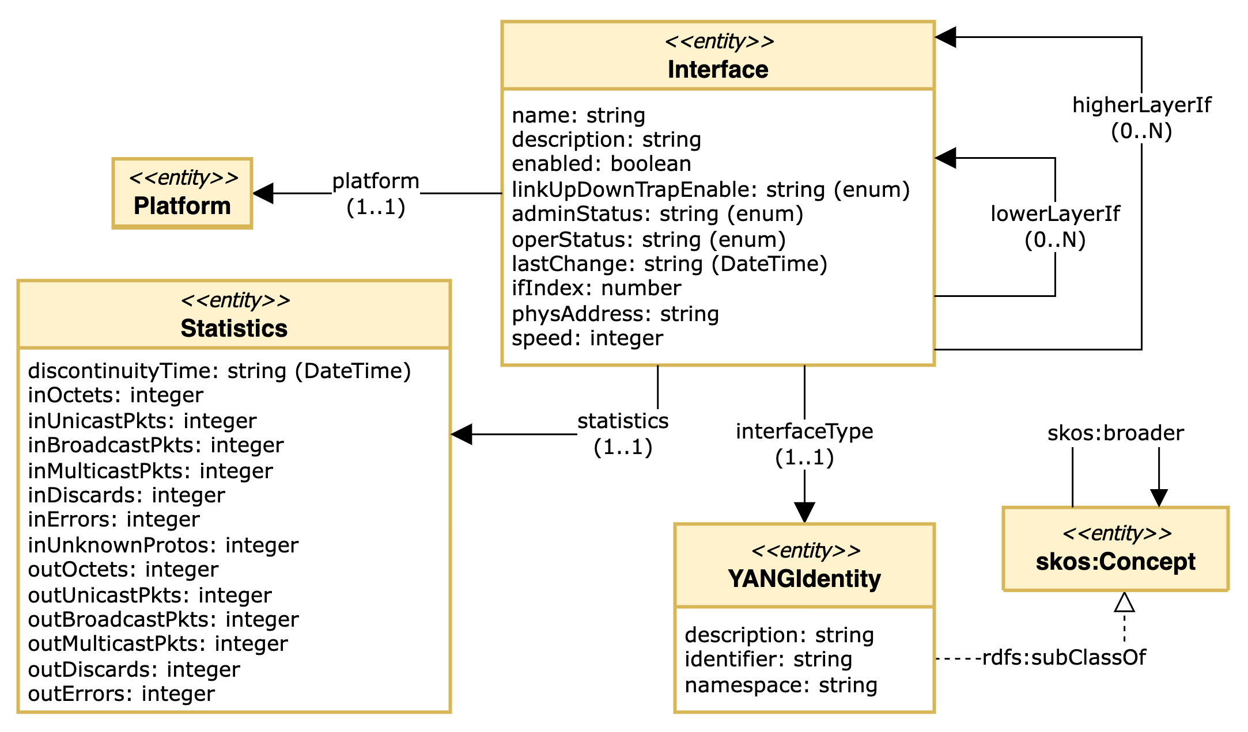
Use case: network interface management
Definition of rules for mapping YANG to knowledge graph based on NGSI-LD
Challenges:
Multiple YANG data models can refer to the same concepts
Even different elements of the same YANG data model can
Lack of standard ontology
Cover core concepts like ”interface” or “input packets”

Slide 63
Data Evolution: Takeaways from industry and future challenges
Knowledge graphs are key to unlocking AI at enterprise level
Facilitates data integration and provides machine-readable representation of knowledge
YANG is widely used in network telemetry…
But not the only data modelling language (RFC 9232)
Data-Centric Networking: the industry is very much looking at ontologies
NMRG can identify and analyze existing standard ontologies
Need to define standard ontologies aligned with work from other areas (e.g., OPSAWG, NETMOD)
Cannot overlook the data mesh wave
https://github.com/network-analytics/draft-daisy-kafka-yang-integration/blob/main/draft-daisy-kafka-yang-integration-04.md
Identify data domains in the network (telemetry planes, use cases)
Guidelines for building data products (quality, data sources)
Draft(s) to discuss data management paradigms for data management
And do not forget data governance…

